Slide 1
Bureau of Meteorology Update
GODEX-NWP 2017

Slide 2
Satellite activities around the Bureau
Upgrade of the Bureau's tracking antennas is complete
Planned/underway:
Establishment of TARS for FY-4
COSMIC-2 antenna (3rd QTR 2017)
Planning for a 5th ground station in Western Australia
Development of Himawari-8 products (precipitation, convective initiation, storm tracking)
Work will soon commence on an operational observations monitoring system for NWP

Slide 3
Non-satellite Observations - radiosondes
High resolution radiosonde data
All upper air stations are issuing high resolution radiosonde data on the GTS (since 16 Nov 2015)
Not being used in NWP yet
Transition to RS41
All stations will transition in 2017, starting with autosondes
A one month comparison campaign will be held in Darwin and Melbourne
Currently working on archive solution

Slide 4
Non-satellite Observations – buoy TAC transition
GODEX-NWP were all aware of the transition, but other key stakeholders were not, including people within GODEX members’ organisations.
There were two “unofficial” methods for communication on this topic:
1. An ECMWF website: https://software.ecmwf.int/wiki/display/TCBUF/TAC+To+BUFR+Migration
2. An email list (maintained by Dean Lockett) nwp-observations-data-quality-issues@wmo.int
In March 2015 the WMO Operational newsletter published information on the transition, but no date for the cessation of the FM18 bulletins was given. The topic was also discussed at ET-MTDCF and the CBS session in 2010.
Everyone agreed that although there was information provided on the transition, the information did not get through to everyone.

Slide 5
NWP Update
Version APS-2 of the Bureau of Meteorology’s global ACCESS-G ("G2") numerical weather prediction system was operationally commissioned on Wednesday 16 March 2016. Significant changes with this upgrade include:
• An increase in model horizontal resolution from N320 (~40km) to N512 (~25km),
• Use of more up-to-date versions of the Met Office UM/VAR/OPS software,
• Switch to using compressed GRIB2 data format (rather than GRIB1) in the model post-processing and MARS archival system.
• Use of new observational data types :
o new CrIS, ATMS and Clear Sky Radiance satellite products;
o additional ATOVS & IASI products from the MetOp-B satellite;
o additional Australian wind profiler observations;
o direct assimilation of Himawari-8 AMVs.

Slide 6
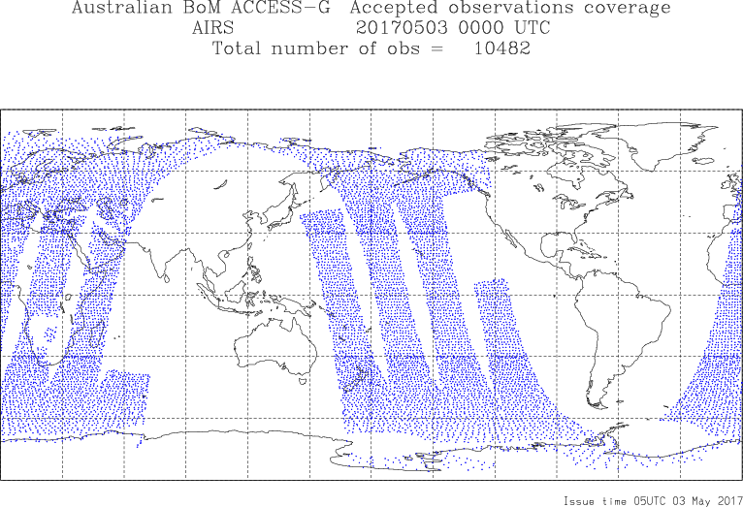
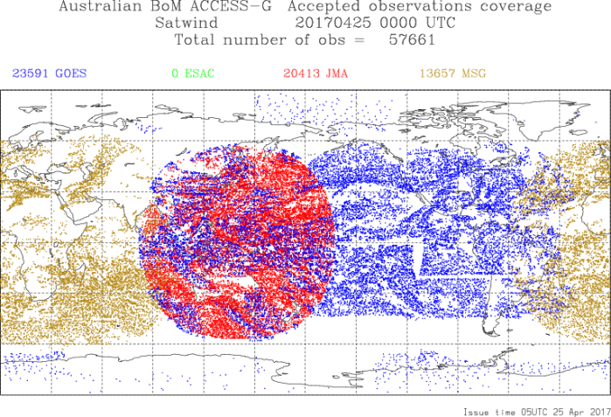
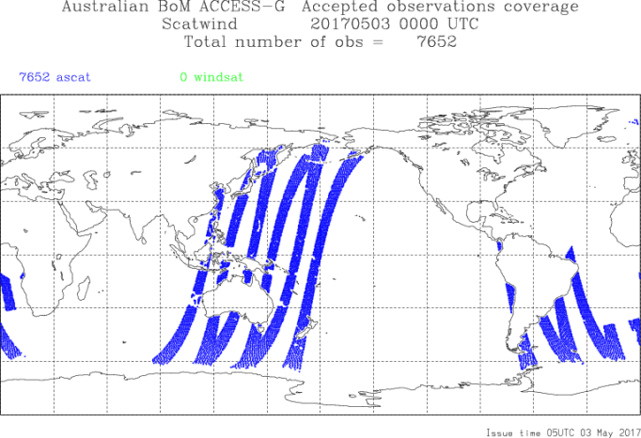
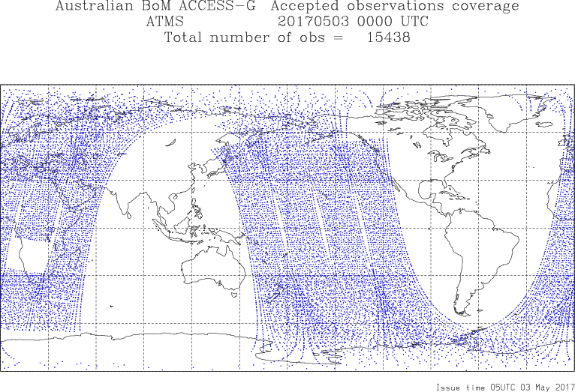
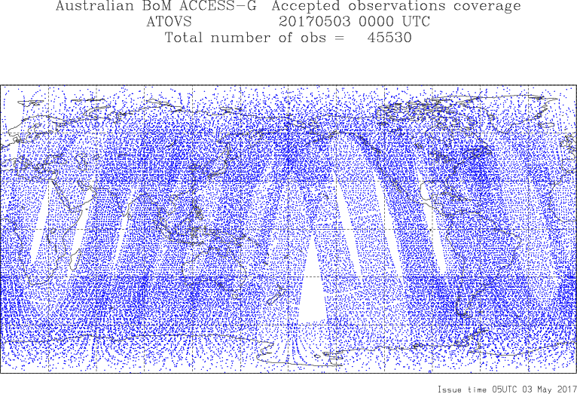
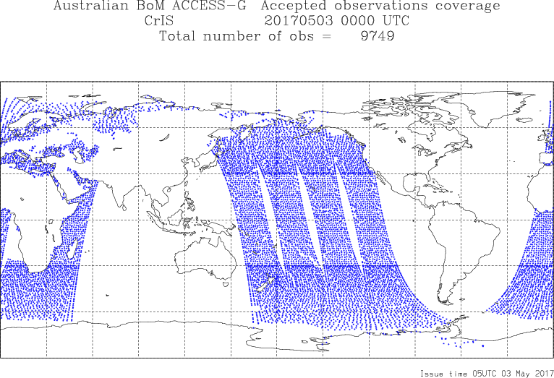
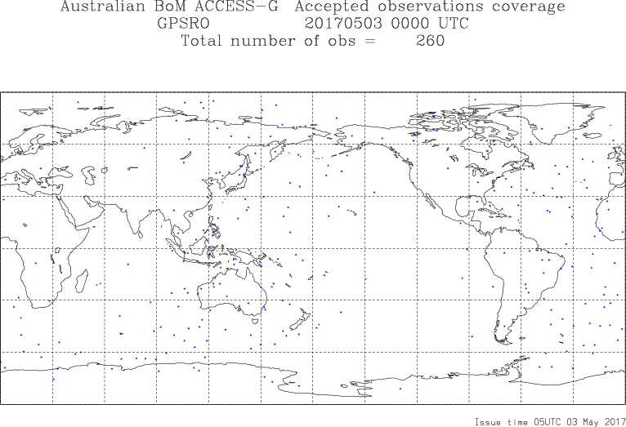
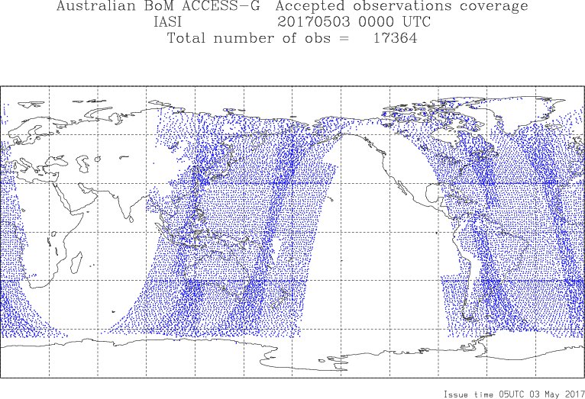
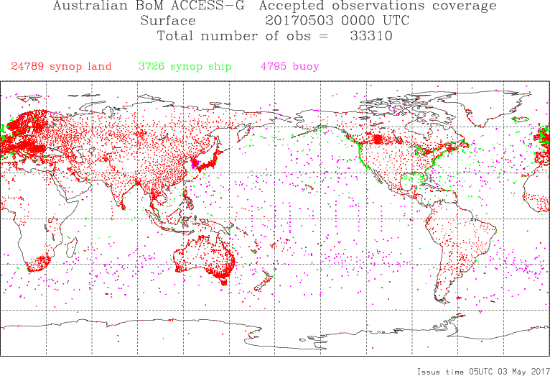

Slide 7
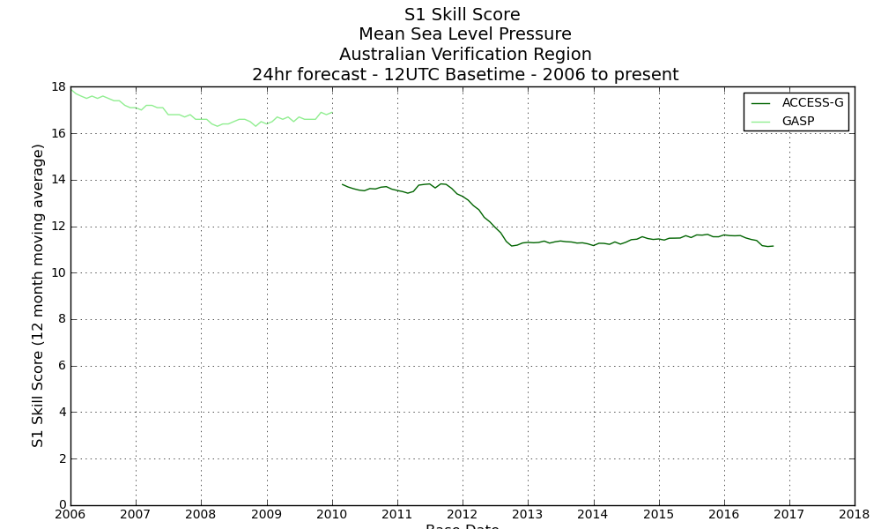
APS0
APS1
APS2
Notes:
APS1 = approx UKMO PS24
Model resolution from 80km to 40km
Atmospheric levels 50 to 70
New satellite obs: IASI (214 channels), GPSRO
More recent version of UM software
Forecast skill improved by approx 12 hours at forecast lead time of 3 days
APS2
Model resolution 40 km to 25km
More up to date version of UM software
New obs (CrIS, ATMS, clear sky radiances, additional ATOVS+IASI from Metop-B, additional wind profilers)
Direct assimilation of Himawari-8 AMVs

Slide 8
NWP observation requirements
Highest priority needs:
LEO/GEO winds (Polar VIIRS winds to be produced in-house by end 2017)
FY-2 winds
Insat winds
Global composite cloud top temp and pressure
SAPHIR radiances
GCOM AMSR2 radiances
FY-3 sounder data
Sentinel-3 SSHA
Global snow analysis
Weather radar from US, African countries, India, Indonesia (future use planned)

Slide 9
Adjoint-based Forecast Sensitivity to Observations (FSO)
We are currently setting up an FSO system to run in conjunction with the operational global NWP suite.
Once running, forecast sensitivity data will be generated, aggregated, analysed and visualised to inform Bureau network planning activities and guide data assimilation research and development.
We also plan to run the system retrospectively to examine observation impacts in particular periods of interest.
Further down the track: extension of the system to higher resolution, limited domain ACCESS systems.
Notes:
In collaboration with the UK Met Office
Aggregates forecast error reduction due to each individual observation
Allows for assessment of the impact of observation types, particular instruments, networks and sub-networks, groups of stations etc.
Only assesses impact of an observation in the presence of all other observations; doesn't tell you directly the effect of removing an observation, or group of observations, or an observing system

Slide 10
GISC Melbourne Portal
Status
April 2013: GISC Melbourne go live
May 2013: RA V workshop covering WIS and TDCF hosed in Melbourne.
Nov 2013 – Aug 2014: RA V in-country visits assisting migration to use of WIS and TCDF.
Feb 2015: Participated in WIS Monitoring Pilot Project
Apr 2015: Made available solar flare forecast: first publication of non-GTS data using WIS.
May 2015: DCPC internal pilot – delivery of ACCESS model data.
Aug 2015: DCPC external pilot with Fiji
Training
On-site visits for the implementation of WIS/TDCF in RA-V in SW Pacific
10 countries from Nov. 2013 to Aug 2014
Development
Started development of www DCPC for subscription to and delivery of NWP model data via WIS

Slide 11
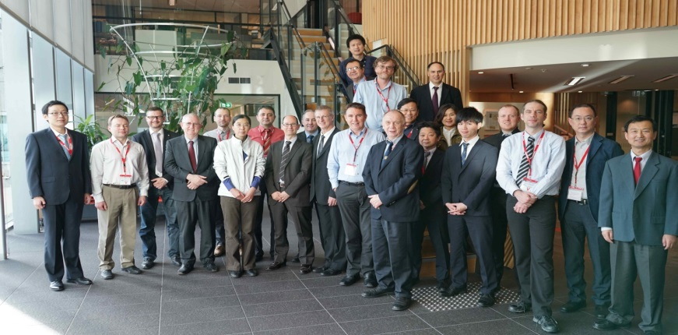
GISC Melbourne Portal
* Sampled at 00:00 14th April 2015 UTC
† April 2016
Joint meeting of the CBS Expert Team on WIS Centres and Task Team on GISCs (Melbourne, Australia. 18-22 April 2016)

Slide 12
Thankyou

Slide 13
Asia Pacific Action Items
Agency | Action Item | Meeting date | Status
CMA | CMA to investigate availability of GNOS radio-occultation data on the GTS (bending angles and refractivity) and similarly from KOMSAT-5 by KMA. | October 2015
CMA | CMA to investigate timeliness of FY-3 global dataset | October 2015
CMA | 1.2.1 Fengyun-3 Sounding Mission – New action: investigate the generation of BUFR and the dissemination of these data via the GTS and CMACast. | May 2014
CMA | 1.2.1 Fengyun-3 Sounding Mission – New action: CMA to work with EUMETSAT to come up with a proposal to add the encoding sequence for the sounding products from Fengyun-3 to the WMO Manual on Codes. ACTION: CMA and EUMETSAT | May 2014
CMA | 3.1. Wind Profiler Data – New action: investigate the distribution of wind profiler data on the GTS. See Action 2011-11-10 | May 2014
BOM | Action 2010-10-05: The Bureau to consider the generation of polar AMVs from MODIS/VIIRS and distribution to the international community in near real time. | October 2012 | The Bureau plans to have operational VIIRS polar winds available by the end of 2017.
All | 1.9 Sentinel - Follow up action to determine requirements for Sentinel series for all users. (separate out different missions in spreadsheet) | May 2014 | The SRAL data onboard Sentinel-3A and 3B are requested. (JMA)
All | Action 2011-11-13 3.6 Ozone Soundings: Centers to investigate the availability of this data for purposes of distribution on the GTS. | October 2012 | The JMA's ozone sounding data are not disseminated via GTS. JMA doesn't have any plan to disseminate the data via GTS. JMA regularly makes monthly reports of the JMA's ozone sounding data to World Ozone and Ultraviolet Radiation Data Centre (WOUDC) at Environmental Canada and JMA’s data are available from the Centre.
 |  |  | The Bureau’s ozone data are quality controlled and made available via the WOUDC. If there is a requirement the uncorrected data could be made available via the GTS.

